Slide 1
GYM MANAGEMENT SYSTEM
A Project on
By
Akash More
Mahipal Lende
Atharva Adrakatti
Pankaj Shahu
Guided by
Ms Pooja Jaiswal

Slide 2
Contents
-> Introduction
-> Project Scope
-> Software Tools and Technologies
-> Entity Relationship Diagram
-> Use-Case Diagram
-> Class Diagram
-> Front End (UI) Pages + Backend Integration

Slide 3
Introduction
Gym Management System Software is a type of web Application software that provides fitness businesses the functionality needed to manage all aspects of their business and efficiently operate their Gym.
It will help the owner/ Administrator to manage the Gym , This software can manage work for Admin, Trainer, customer.
Maintain Data of Members includes Fees, Membership type, Workout plan, Diet Plan, Trainer etc.

Slide 4
Project Scope
Project Scope consists of the 3 major roles which are Admin, Trainer and Member.
Admin : Admin is owner of the gym, we have one admin web application. Admin will be able to Sign in, Update, Delete, Insert Member and Trainer Info, Access to workout and diet plans of member and have access to whole application.
Trainer : Trainer is the coach for Member who will add their workout plans, diet plans, plan for their exercise. Trainer has their own login which will be given by admin.
User : User will first visit our website and register for the same, they will have all the information related to gym before login. After logging in user can checkout for the different membership plans and opt for it. User will be assigned their workout and diet plans on their login.

Slide 5
Software Tools and Technologies
Front-End (Client Side) : React.js
-> React is a popular front-end JavaScript library that allows developers to build interactive user interfaces for web applications.
Modular and reusable components.
Improved performance.
Large and active community.
Better developer experience.
Cross-platform compatibility.
-> React is a powerful tool for building modern web applications with a focus on performance, scalability, and reusability.

Slide 6
Software Tools and Technologies
Backend ( Server-side) : J2EE Spring Boot
-> Spring Boot is a popular Java-based framework for building server-side applications
Rapid development
Microservices architecture
Dependency management
Easy integration
Cloud-native development
Large community
-> Spring Boot provides a powerful and flexible framework for building server-side applications in Java, with a focus on ease of development, scalability, and cloud-native architecture

Slide 7
Software Tools and Technologies
Database Technology : MySQL
-> MySQL is a popular open-source relational database management system (RDBMS) that is widely used in projects for several reasons:
Reliability
Ease Of Use
Flexibility
Scalability
Security
Community Support
-> MySQL is a reliable, easy-to-use, and flexible database system that provides strong performance and scalability, making it a preferred choice for many projects.

Slide 8
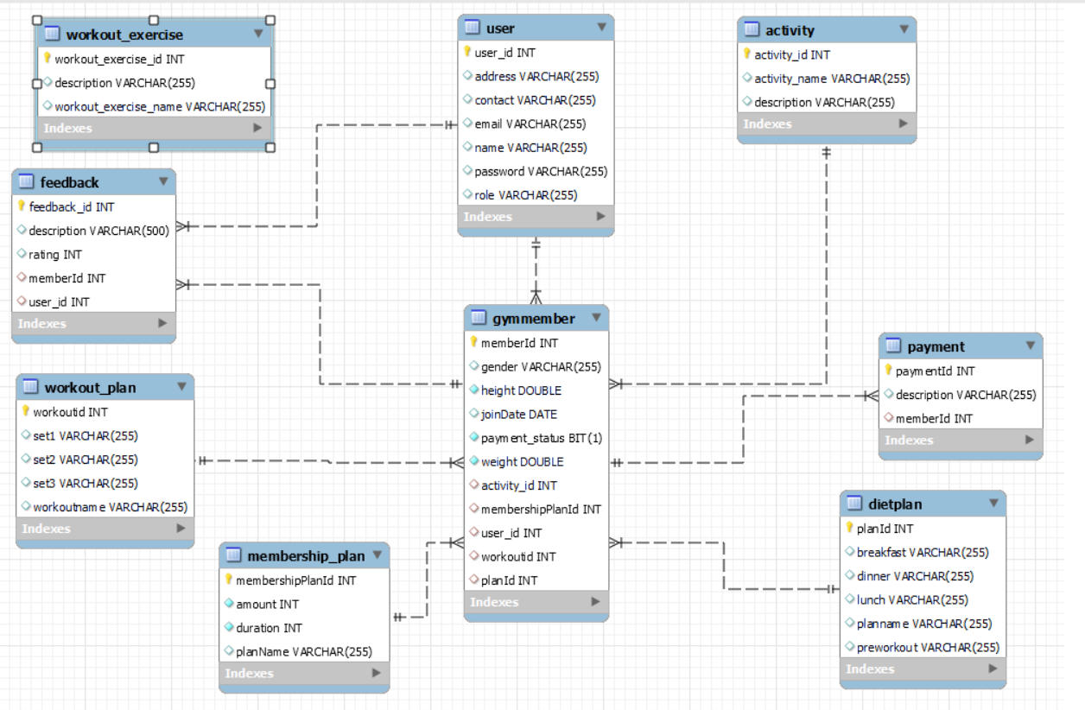
Entity-Relationship Diagram

Slide 9
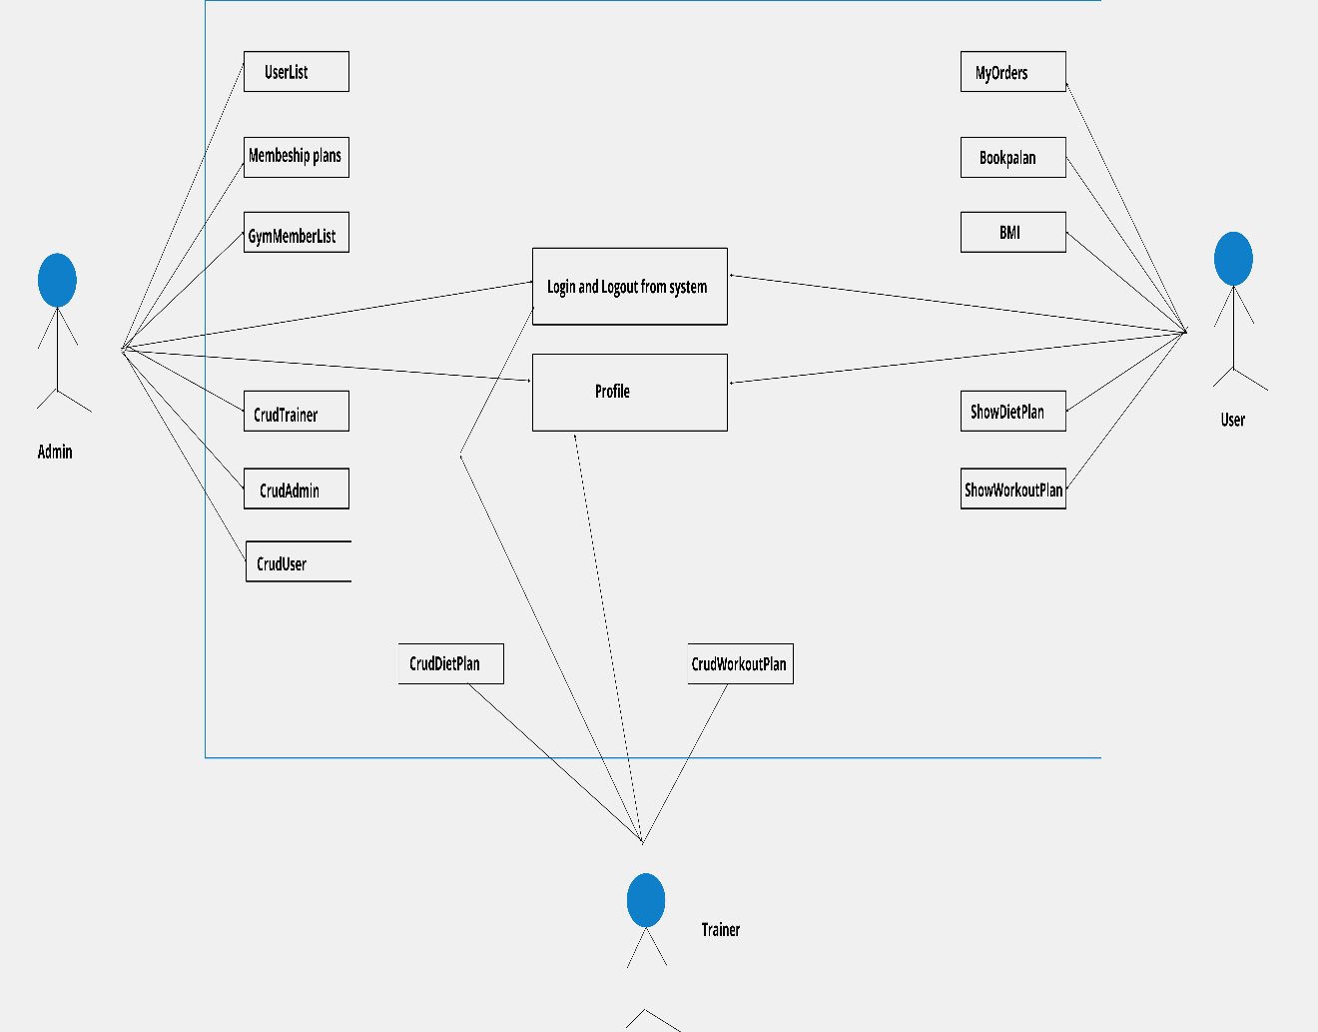
Use-CAse Diagram

Slide 10
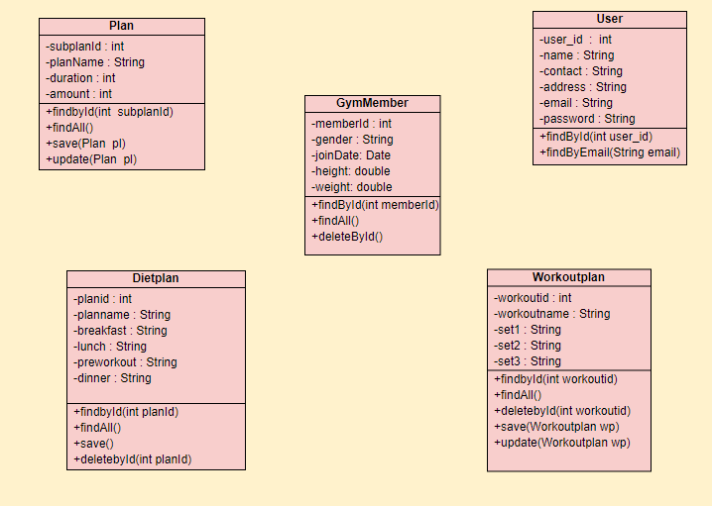
Class Diagram

Slide 11
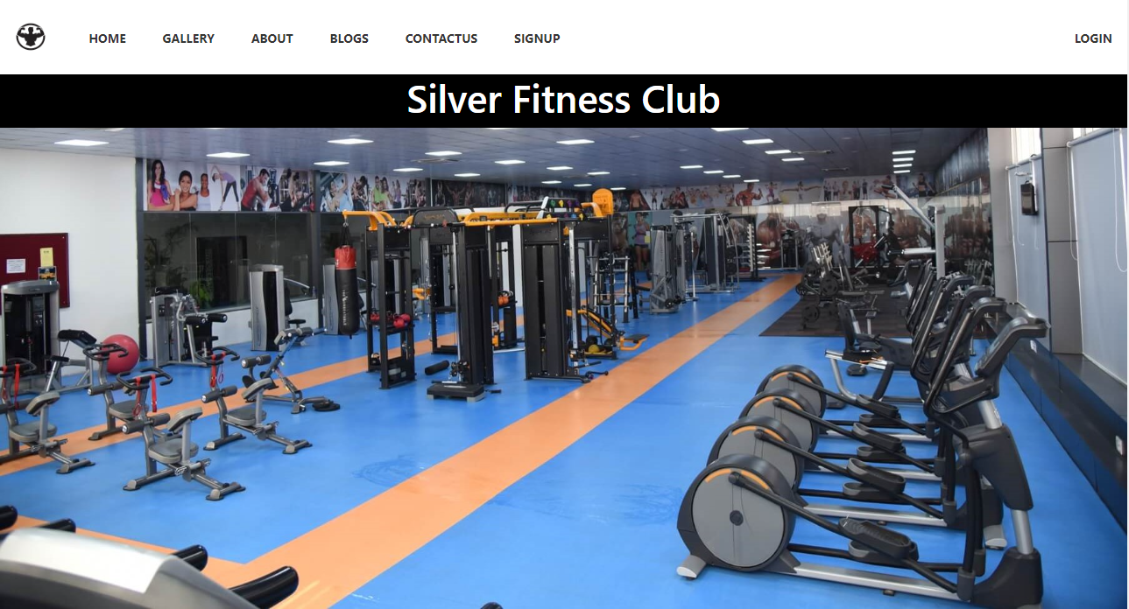
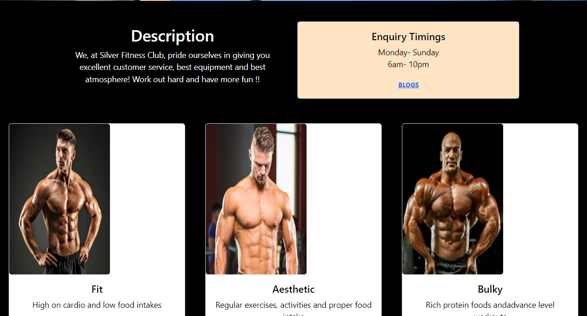
Home Page

Slide 12
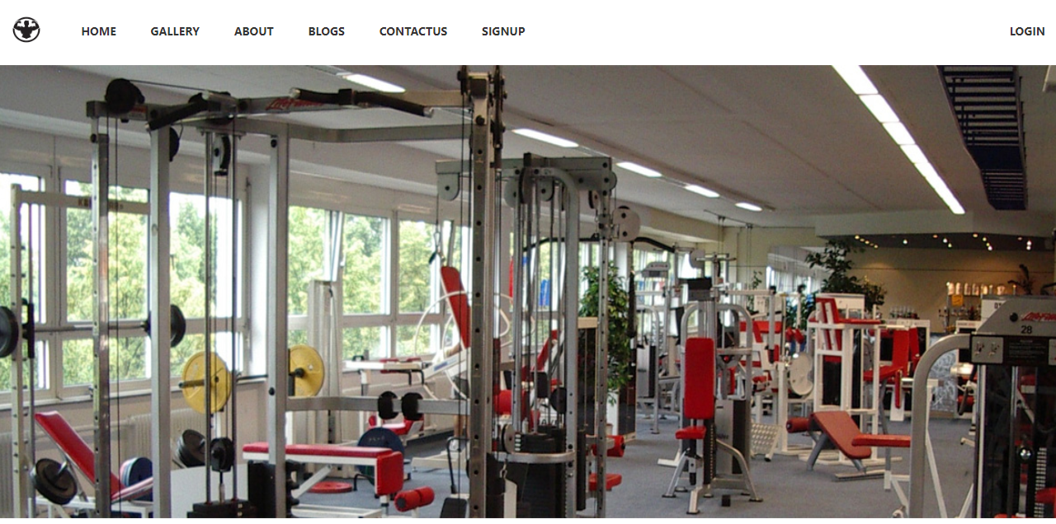

Gallery

Slide 13
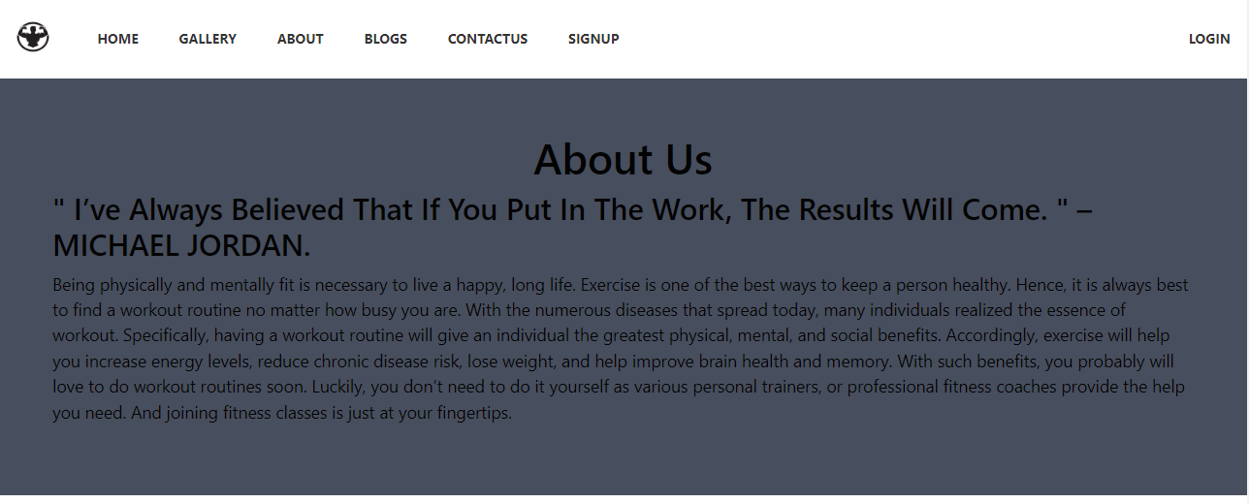
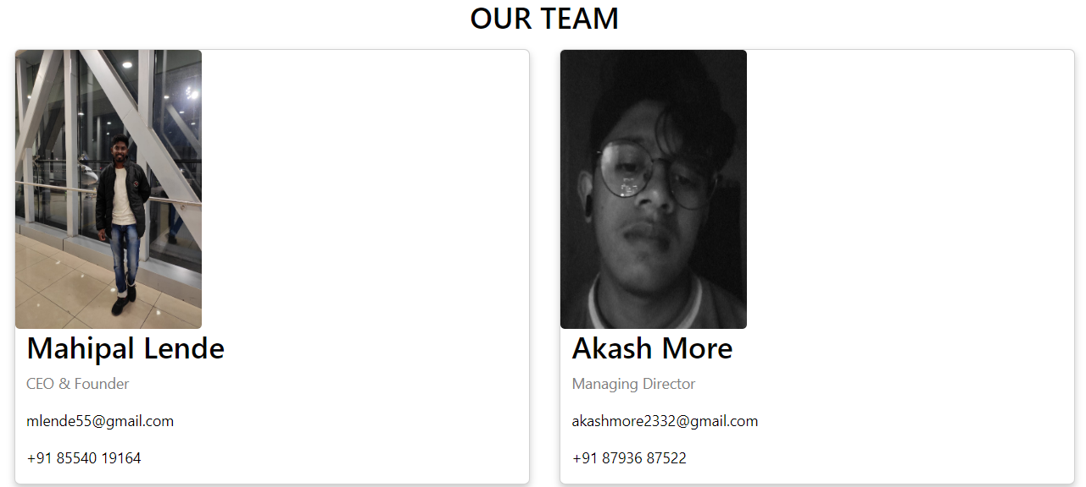
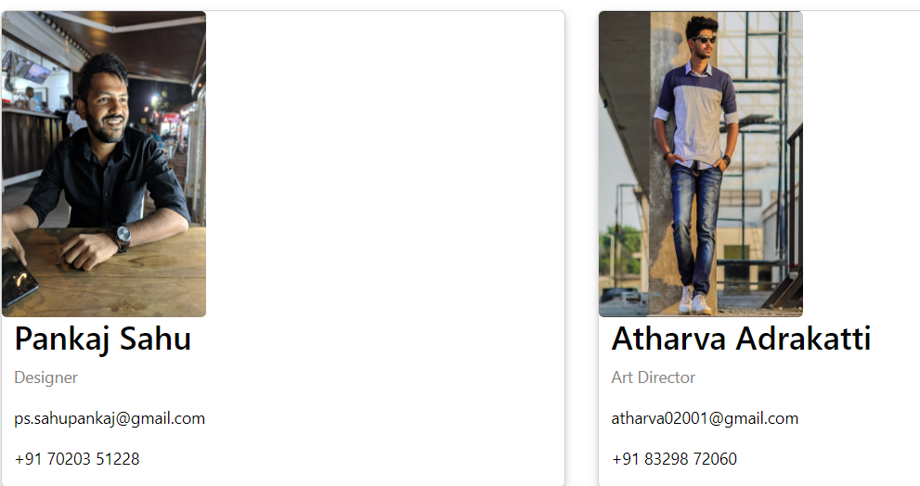
About US

Slide 14

Blogs

Slide 15
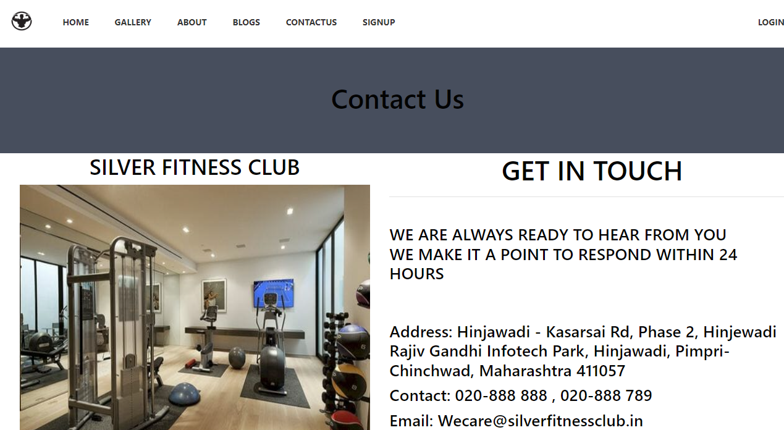
Contact Us

Slide 16
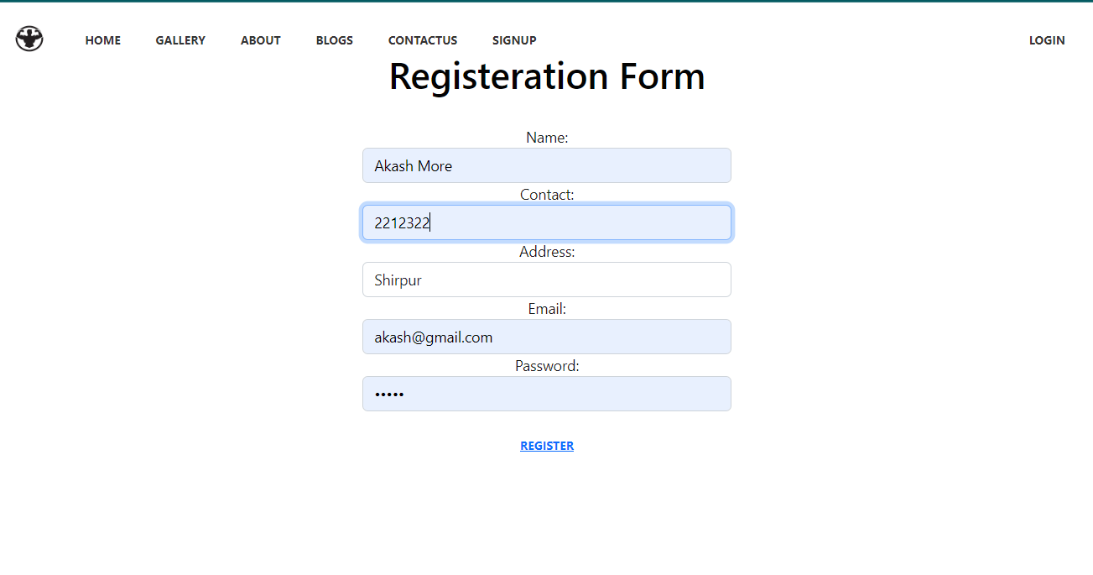
Registration
From front end we are passing data to backend api
'http://localhost:8080/users/saveUser'
In backend we are processing it with usercontroller's method
@PostMapping("/users/saveUser")
public ResponseEntity<User> createUser(@RequestBody User user){
}

Slide 17
createUser method is calling method of service layer
User createUser(User user);
And this service layer method is calling dao’s method
DAO method save
User newUser = userdao.save(user);

Slide 18
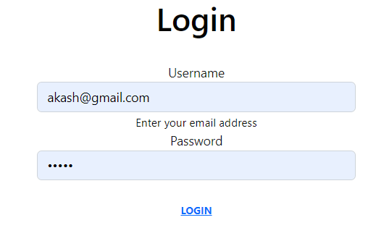
Login
Based on your role if u are valid member u will be redirected to specific UI
Ex. If you are admin then u will be shown AdminUI
In backend we are sending data to
'http://localhost:8080/login'

Slide 19
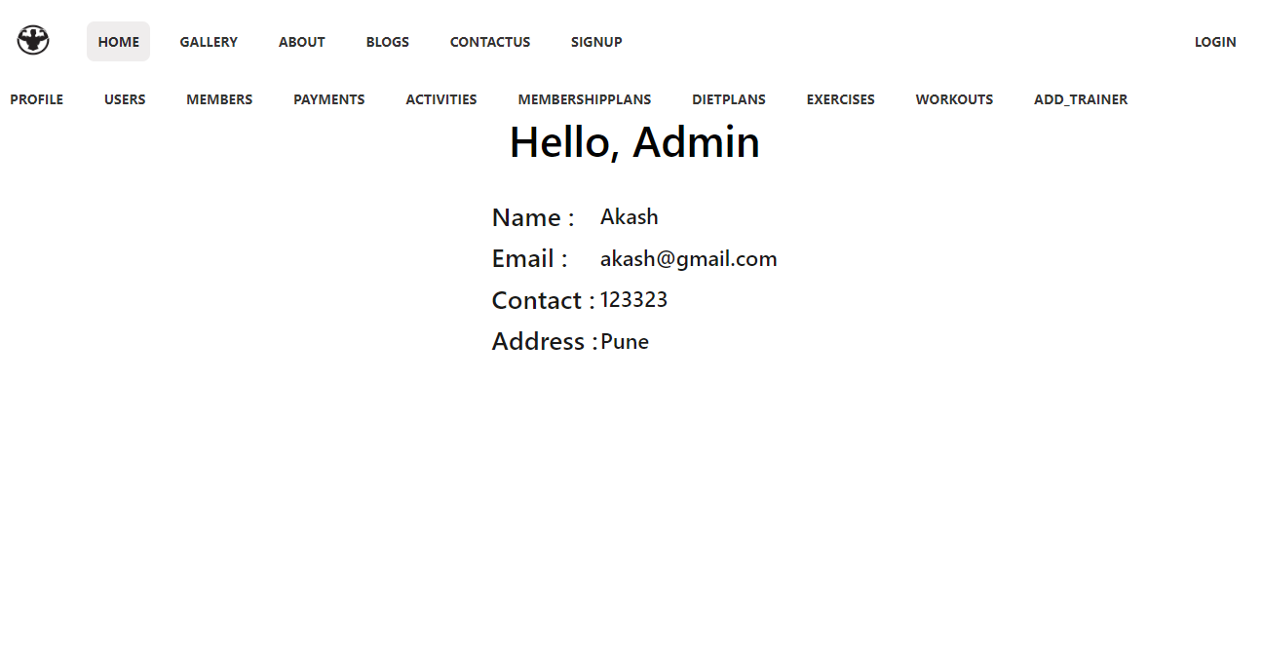
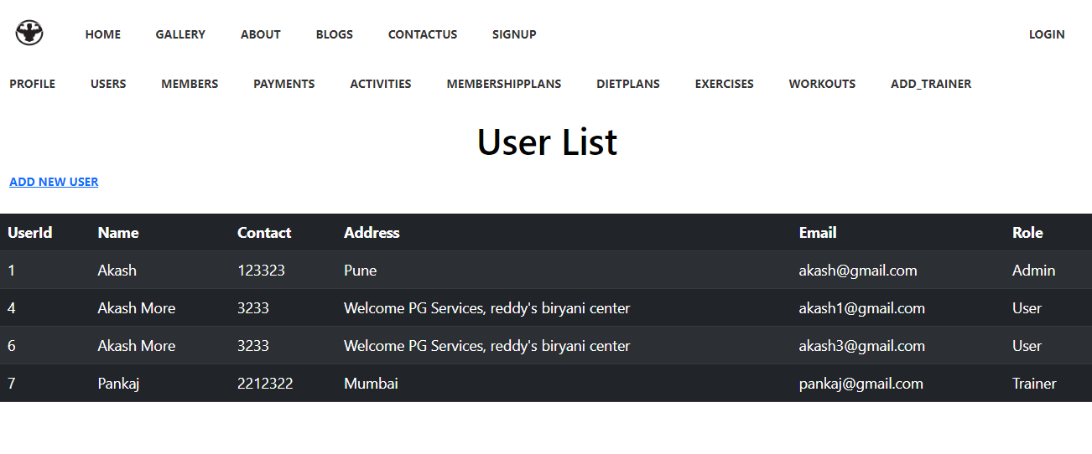
Admin UI
Profile Page
User’s List

Slide 20
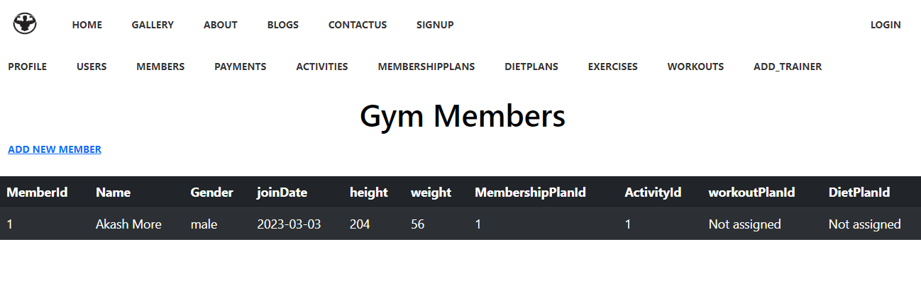
For getting all users we are calling dao’ layers method findAll in service layer’s
Method findAll .
Same with members, we are getting member list (i.e users who have bought
Membership)

